Slide 1
Group project 2
Threat Hunting Using SIEM and MITRE Mapping

Slide 2
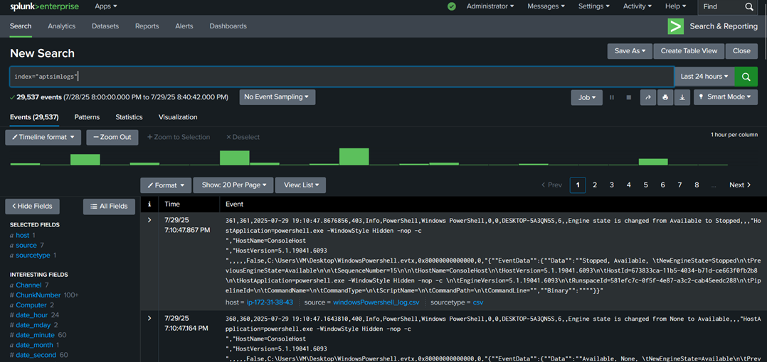
objectives
Simulate an attack and extract the logs.
Upload them into a SIEM for analysis.
Map our findings with MITRE ATT&CK

Slide 3
Roles & activities
• Damien Rodziewicz-INT250041
Role(s): Team Lead, Analyst Lead, Research Team, Presentation Lead Activities: Group Leader, SIEM Setup, Attack Simulation, Dashboard Creation, Presentation
• Melisa Nyamukondiwa-INT250022
Role(s): Report Writer, Analyst, Research Team, GitHub Lead
Activities: Report Writing, Dashboard Creation, GitHub Posting
• Sunday Dorcas Idorenyin - INT250363
Role(s): Analyst, Research Team
Activities: Dashboard Creation, MITRE Mapping and Mitigations
• Onah Nelson-OCHELLE - INT250427
Role(s): Analyst, Research Team
Activities: MITRE Mapping, Mitigations and Lessons Learned
• Onyekachi Jude Nwizu- INT250501
Role(s): Analyst, Research Team
Activities: Research

Slide 4
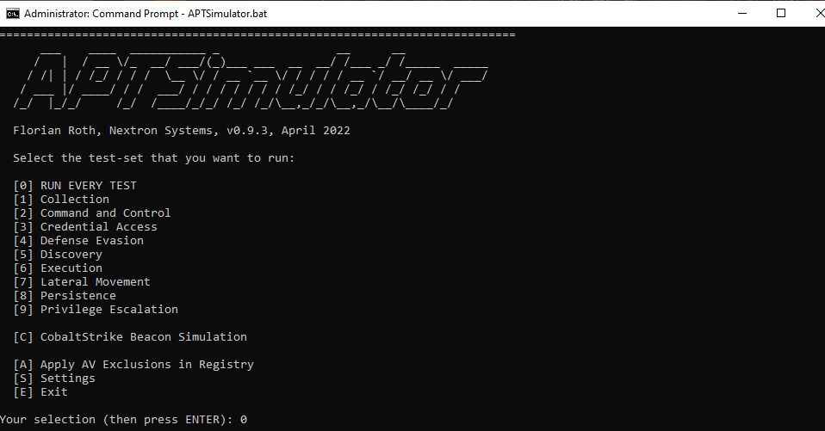
Frameworks/tools used
AWS
Splunk
VirtualBox
Sysmon
APTSimulator
MITRE ATT&CK
GitHub

Slide 5
Approach
Team Roles and Responsibilities: We decided on our roles such as Group Lead, Researcher, Analyst, Report Writer etc.
SIEM Selection: We opted to use Splunk as it’s an industry standard.
Log collection: Utilized APTSimulator on a Windows VM to generate logs.
Threat Analysis & MITRE Mapping: Utilized Splunk to identify suspicious events to which we could then map observed activity with MITRE ATT&CK techniques.

Slide 6
findings
Local users were enumerated.
New local users created and added to privileged groups.
Logon scripts were manipulated to automate unauthorized system access, demonstrating persistence techniques.
“Attackers” extracted credentials from Windows Credential Manager, highlighting vulnerabilities within the credential storage.

Slide 7
mitigations
Utilize MFA, strong passwords and least privilege access.
Limit access to credential storage.
Enable key logging.
Monitor and audit logs regularly.
Have a trained SOC team/teams.
Utilize a SIEM to alerts suspicious behavior.

Slide 8
Lessons learned
How to setup and utilize a SIEM for threat hunting.
Proper Sysmon and Splunk setup is necessary for effective threat hunting.
Dashboards are useful but depend on complete log data.
Strong authentication and least privilege are key defenses.
Mapping to MITRE ATT&CK helps to guide investigation priorities.

